Slide 1
11th September 2023
Sofia Belloni – s303393
Damiano Ferla – s305953
ADVANCED MACHINE LEARNING:
PROJECT 5 – ANOMALY DETECTION

Slide 2
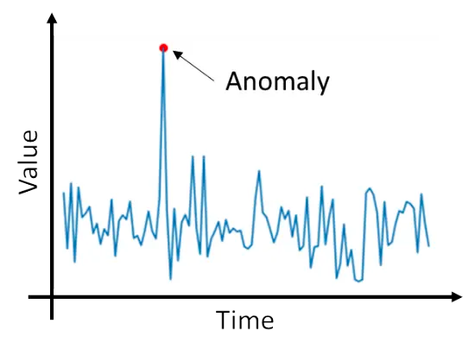
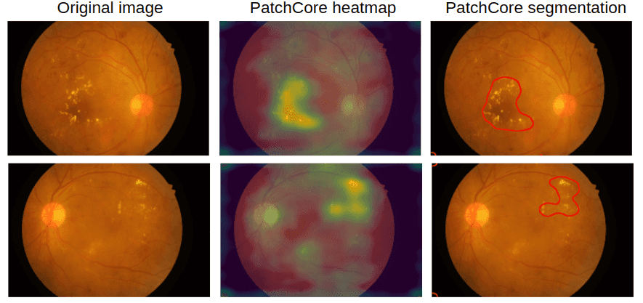

Introduction: Background
This project covers two main tasks:
Anomaly detection
Anomaly segmentation
1

Slide 3
Introduction: Problem Description
The cold-start problem
Past approaches didn’t perform very well…
Inference times
2

Slide 4
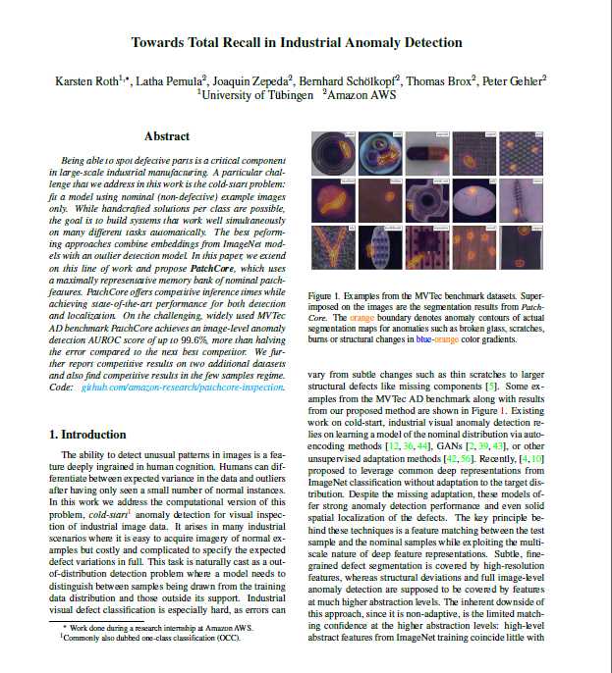
Introduction: PatchCore
«Towards Total Recall in industrial anomaly detection», CVPR 2022
New approach to the industrial anomaly detection and segmentation
Main achievements:
Maximize nominal information available at test time
Reduce biases towards ImageNet classes
Improve inference times
3

Slide 5
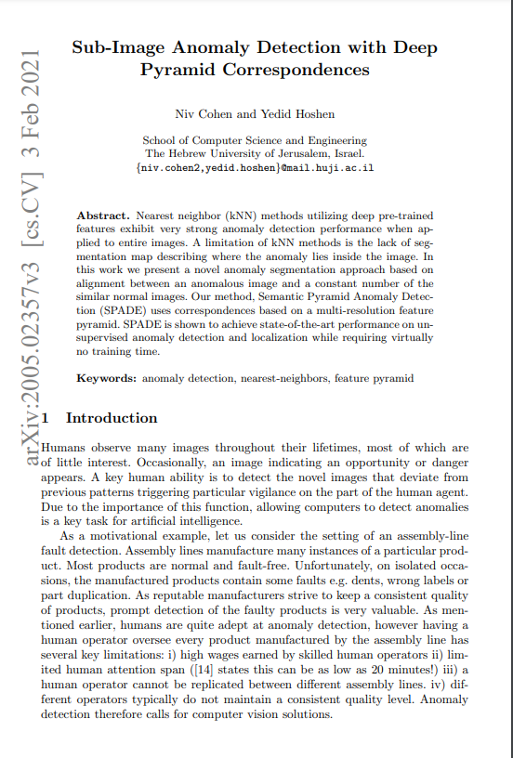
Related Works: SPADE
«Sub-Image Anomaly Detection with Deep Pyramid Correspondences»
It identifies anomalies from the normal behaviour of regions
Enables the detection of localized anomalies withing images
What PatchCore takes from it?
4

Slide 6
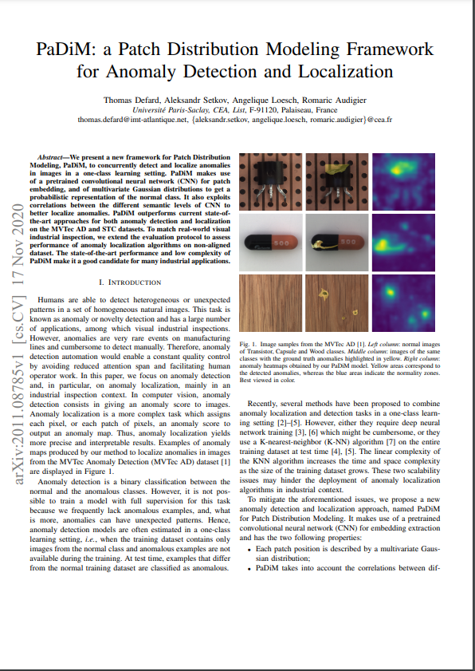
Related Works: PaDiM
«PaDiM: a Patch Distribution Modeling Framework
for Anomaly Detection and Localization»
Patch features extration using a pre-trained CNN
Mahalanobis distance
Regions exceeding a predefined threshold are classified as anomalies
What PatchCore takes from it?
5

Slide 7
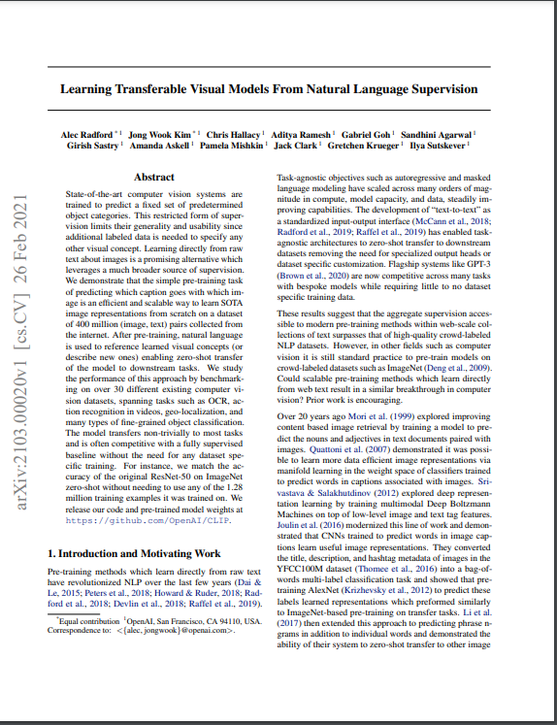
Related Works: CLIP
«Learning Transferable Visual Models From Natural Language Supervision»
Contrastive Language-Image Pretraining
It combines text and images.
What PatchCore takes from it?
6

Slide 8
Main Contribution
Original PatchCore:
Error Reduction: 57% from PaDiM
ROC-AUC score (AD): 99.1% of PatchCore-25%
Pixelwise ROC-AUC score (AS): 98.1% of PatchCore-25%
Inference Time: 0.22 seconds
Re-implemented PatchCore:
ROC-AUC score (AD): 96.4% of PatchCore-25%
Pixelwise ROC-AUC score (AS): 97.2% of PatchCore-25%
CLIP Integration:
ROC-AUC score (AD): 96.4% +0.9% of PatchCore-25%
Pixelwise ROC-AUC score (AS): 97.2% -0.1% of PatchCore-25%
7

Slide 9
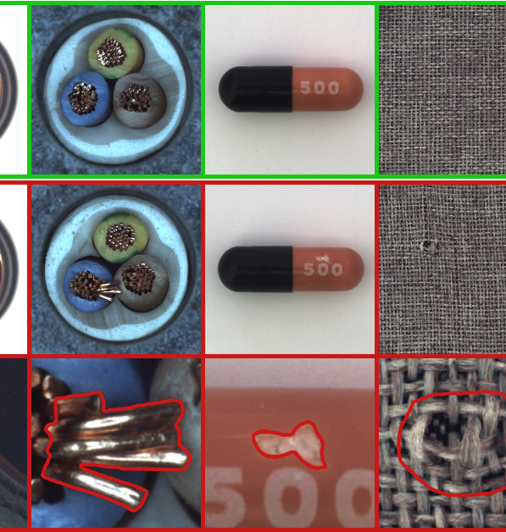
PatchCore implementation
Local Patch Features aggregated into a memory bank​
Core-set reduction​
Anomaly detection and localization​
Extension: CLIP Pre-Training​
8

Slide 10
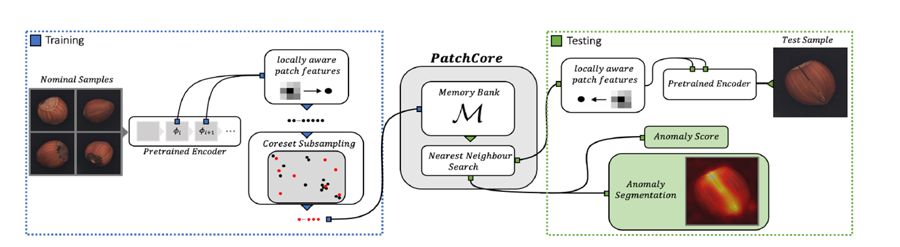
Method: Local patch feature aggregated into a memory bank (I)
PatchCore uses pre-trained ResNet50 on ImageNet
Features representation: extract feature from layer 2 and 3
9

Slide 11
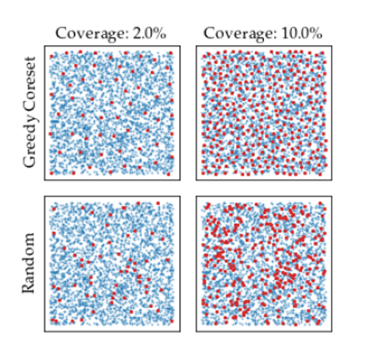
Method: Core-set subsampling (II)
Random subsampling or Core-set subsampling?
But the computation of the approximated memory bank is complex…
Minimax facility location metric
10

Slide 12
Method: Anomaly Detection and Segmentation(III)
Nearest-neighbor approach to detect anomalies
Score = Maximum distance between test patch-features and their closest neighbor
Realign this score on the original image for localization
11

Slide 13
Extension: CLIP Pre-Training (IIII)
Changed only the pre-training, keeping the rest of the network the same
Custom hook in the forward step for feature extraction
Different imges's preoprocessing, CLIP requires working with RGB images
12

Slide 14
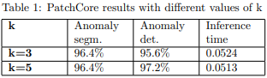
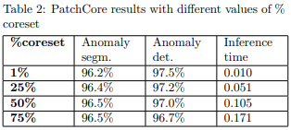
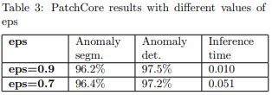
The experiments(I)
MvTec dataset
AUROC metrics
Hyperparameters
k
coreset percentage
eps
13

Slide 15
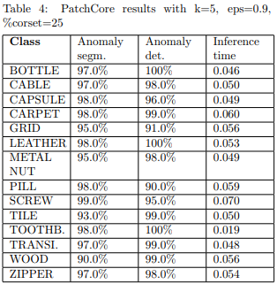
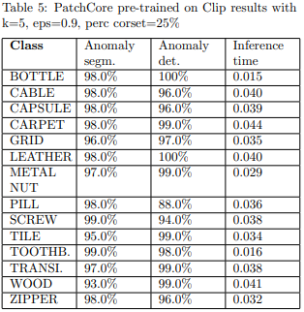
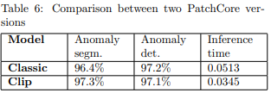
Best hyperparameters values:
The experiments(II)
K = 5, % coreset = 25%, Eps = 0.9
14

Slide 16
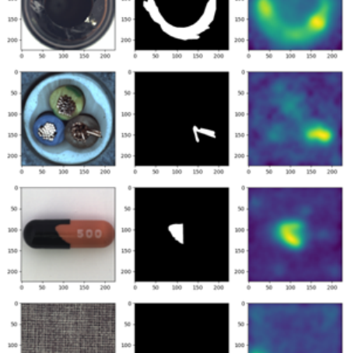
Conclusions
To conclude, we can say that PatchCore:
Retain high inference speeds
Reducing biases towards pre-trained dataset’s classes
In future, it would be interesting to add a finetuning of the network on the images of the specific task to potentially achieve even better results.
15

Slide 17
Damiano Ferla, Sofia Belloni
Advanced Machine Learning – 2022/2023
Project 5
THANKS FOR YOUR
ATTENTION!

Slide 18
References
Our project: https://github.com/DamoFlare/PatchCore2.0/tree/main
PatchCore: https://arxiv.org/abs/2106.08265
Slide 1 image: https://www.analyticsvidhya.com/blog/2021/06/univariate-anomaly-detection-a-walkthrough-in-python/
Slide 3 image: https://arxiv.org/abs/2106.08265
Slide 4 image: https://arxiv.org/abs/2005.02357
Slide 5 image: https://arxiv.org/abs/2103.00020
Slide 6 image: https://arxiv.org/abs/2103.00020
Slide 8 image: https://www.mvtec.com/company/research/datasets/mvtec-ad
Slide 9, 10, 11 and 12 images: https://arxiv.org/abs/2106.08265

